Slide 1
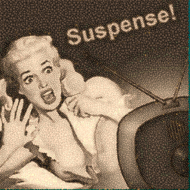
Suspense
There is no terror in the bang, only in the anticipation of it.
-Alfred Hitchcock

Slide 2
Suspense: the uncertainty or anxiety a reader feels about what will happen next in a story
there must be an unknown; a suspicion, a mystery, a danger we expect
The word suspense is related to the word suspended. When a story keeps us in suspense, we feel almost as if we were suspended in midair. We may even hold our breath without realizing it as we read on eagerly to find out how the story ends.

Slide 3
Suspense is built with details, innuendo, setting, actions
And can be deepened through:
dreams: what can happen, nightmares of the character’s fears, flashbacks of a haunted past
clues: letters, journals, pictures, evidence, items, etc.
time & weather: night, thunderstorms, blizzards, cold
senses: smell of blood, taste of fear, sound of scraping, dark or vivid colors, etc.
villain: background, greed, jealousy, insanity, etc.

Slide 4
Four Main Elements of Suspense
Foreshadowing
the writer may give clues, sometimes even false clues, that hint at what will happen later in the story
Examples:
a gun found in a drawer may hint at violence later
As dark clouds rolled in, a brisk wind raised bumps all over my skin.

Slide 5
Four Main Elements of Suspense
Mystery
The author withholds information (Who is the murder? How was the crime committed?) or includes something difficult or impossible to explain.
Any Unusual or mysterious circumstance can create suspense.
Examples:
The main character may get a cryptic letter from an unknown sender
Suddenly a scream pierced the night. I leapt to my feet. I stood totally motionless. All was silent…and then it came again, only this time closer to us.

Slide 6
Four Main Elements of Suspense
Dilemma
A character, especially one we care about, is in great peril or must choose between two dangerous courses of action
What will the character choose? Will he/she succeed?
Examples:
The main character may have to choose whether or not to follow a suspicious character down a dark stairway.
In the Hunger Games, Katniss has to decide between killing Peeta or herself

Slide 7
Four Main Elements of Suspense
Reversal
The situation suddenly changes from good to bad or vice-versa; a sudden shift in plot direction
An unexpected change that leaves the reader wondering what will happen next
Examples:
A “friend” really turns out to be working against the main character or passing information to those who are after him.
In Freak the Mighty, as Loretta is freeing Max and we think he is going to be safe, Killer Kane grabs Loretta by the throat.

Slide 8
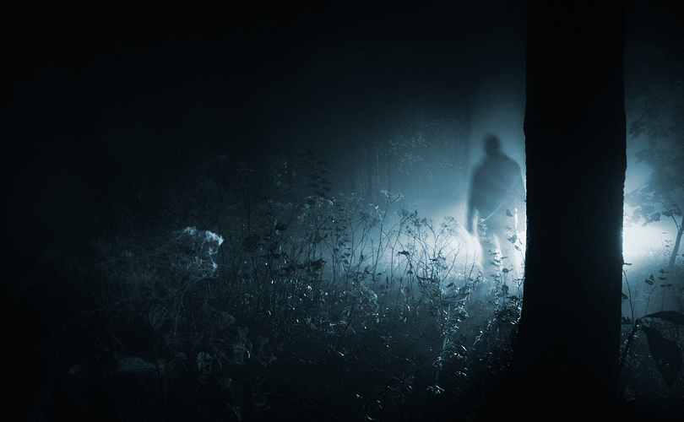
Suspense makes you stay on your toes. You never know what will happen.

Slide 9
Practice
Find an example of each:
“The Eye of the Beholder”
“Open Window”- page 110

