Slide 1
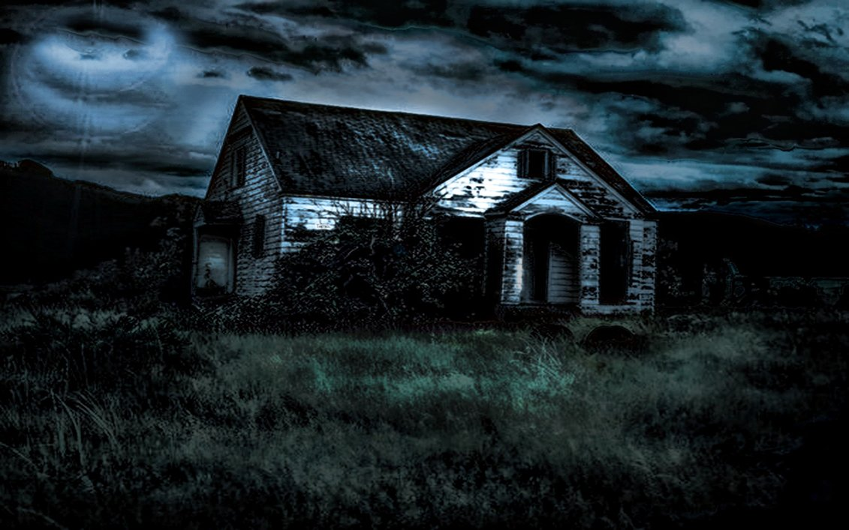
Write a story that takes place in this house.
IN THE WRITING JOURNAL TAB IN YOUR BINDER

Slide 2
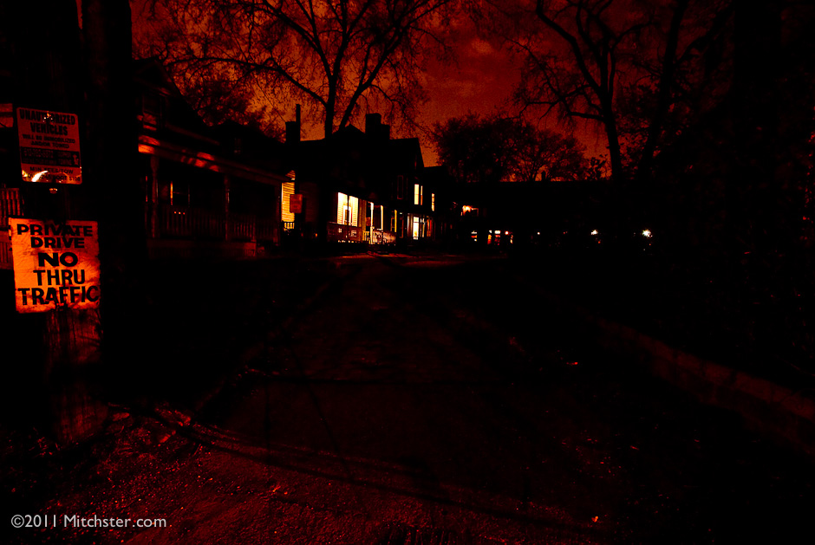
In the writing journal tab in your binder, copy the sentences and finish this story.
It was Halloween. I was on my way home, when suddenly I got an eerie feeling…

Slide 3
Write this story.
IN THE WRITING JOURNAL TAB IN YOUR BINDER

Slide 4
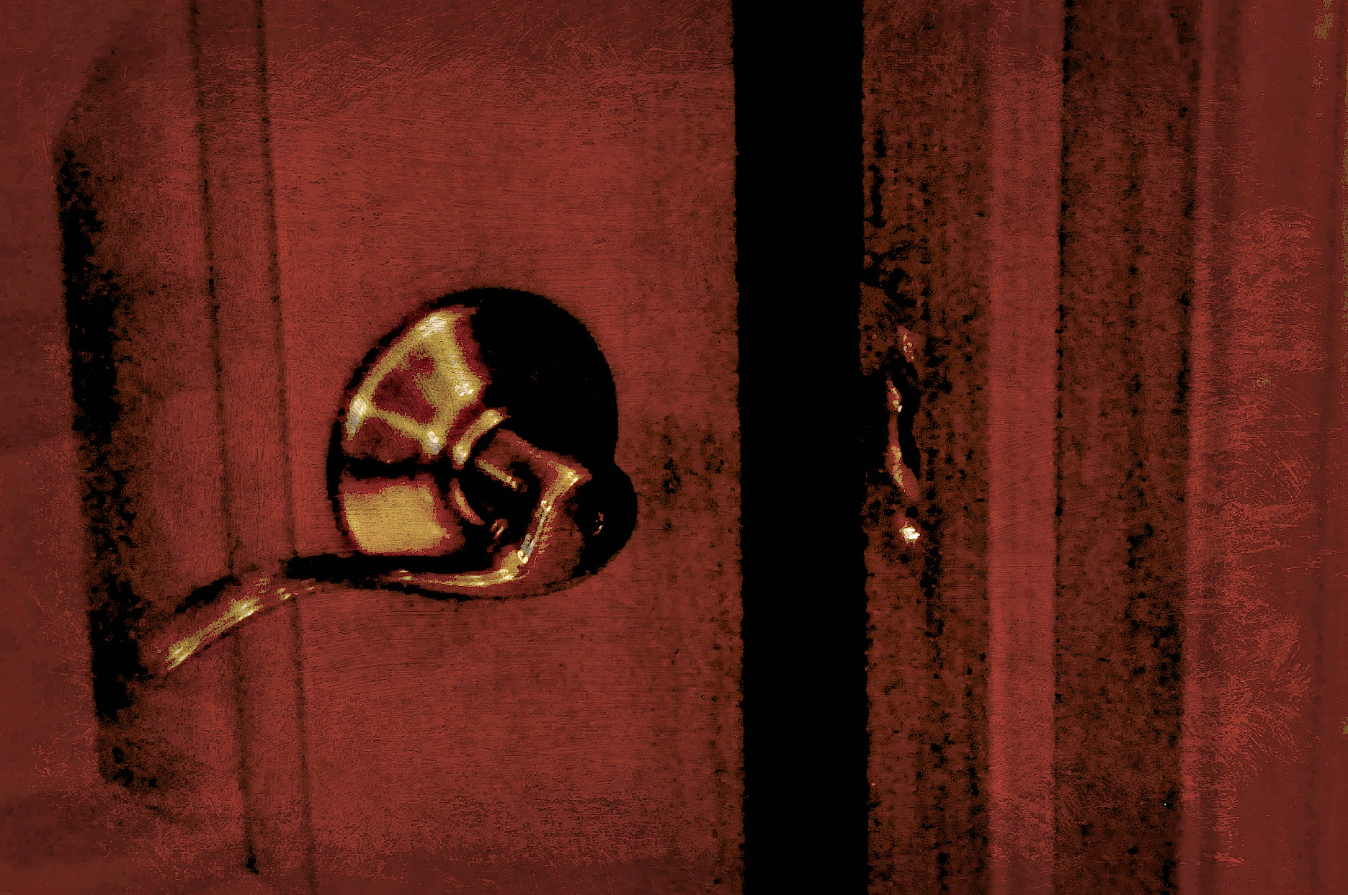
Something in the closet was making a strange noise, so I opened the door and…
In the writing journal tab in your binder, copy the sentences and finish this story.

Slide 5
She heard her mom call her name from downstairs, so she got up and started to head down. As she got to the stairs, her mom pulled her into her room and said, “I heard that, too.”
In the writing journal tab in your binder, copy the sentences and finish this story.

Slide 6
IN THE WRITING JOURNAL TAB IN YOUR BINDER

Slide 7
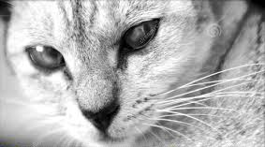
I always thought my cat had a staring problem- she always seemed fixated on my face. Until one day, when I realized that she was always looking just behind me.
In the writing journal tab in your binder, copy the sentences and finish this story.

Slide 8
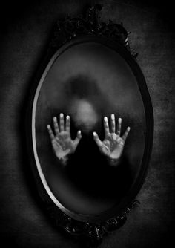
In the writing journal tab in your binder, copy the sentences and finish this story.
I woke up to hear knocking on the glass. At first, I thought it was the window until I heard it come from the mirror again.

Slide 9
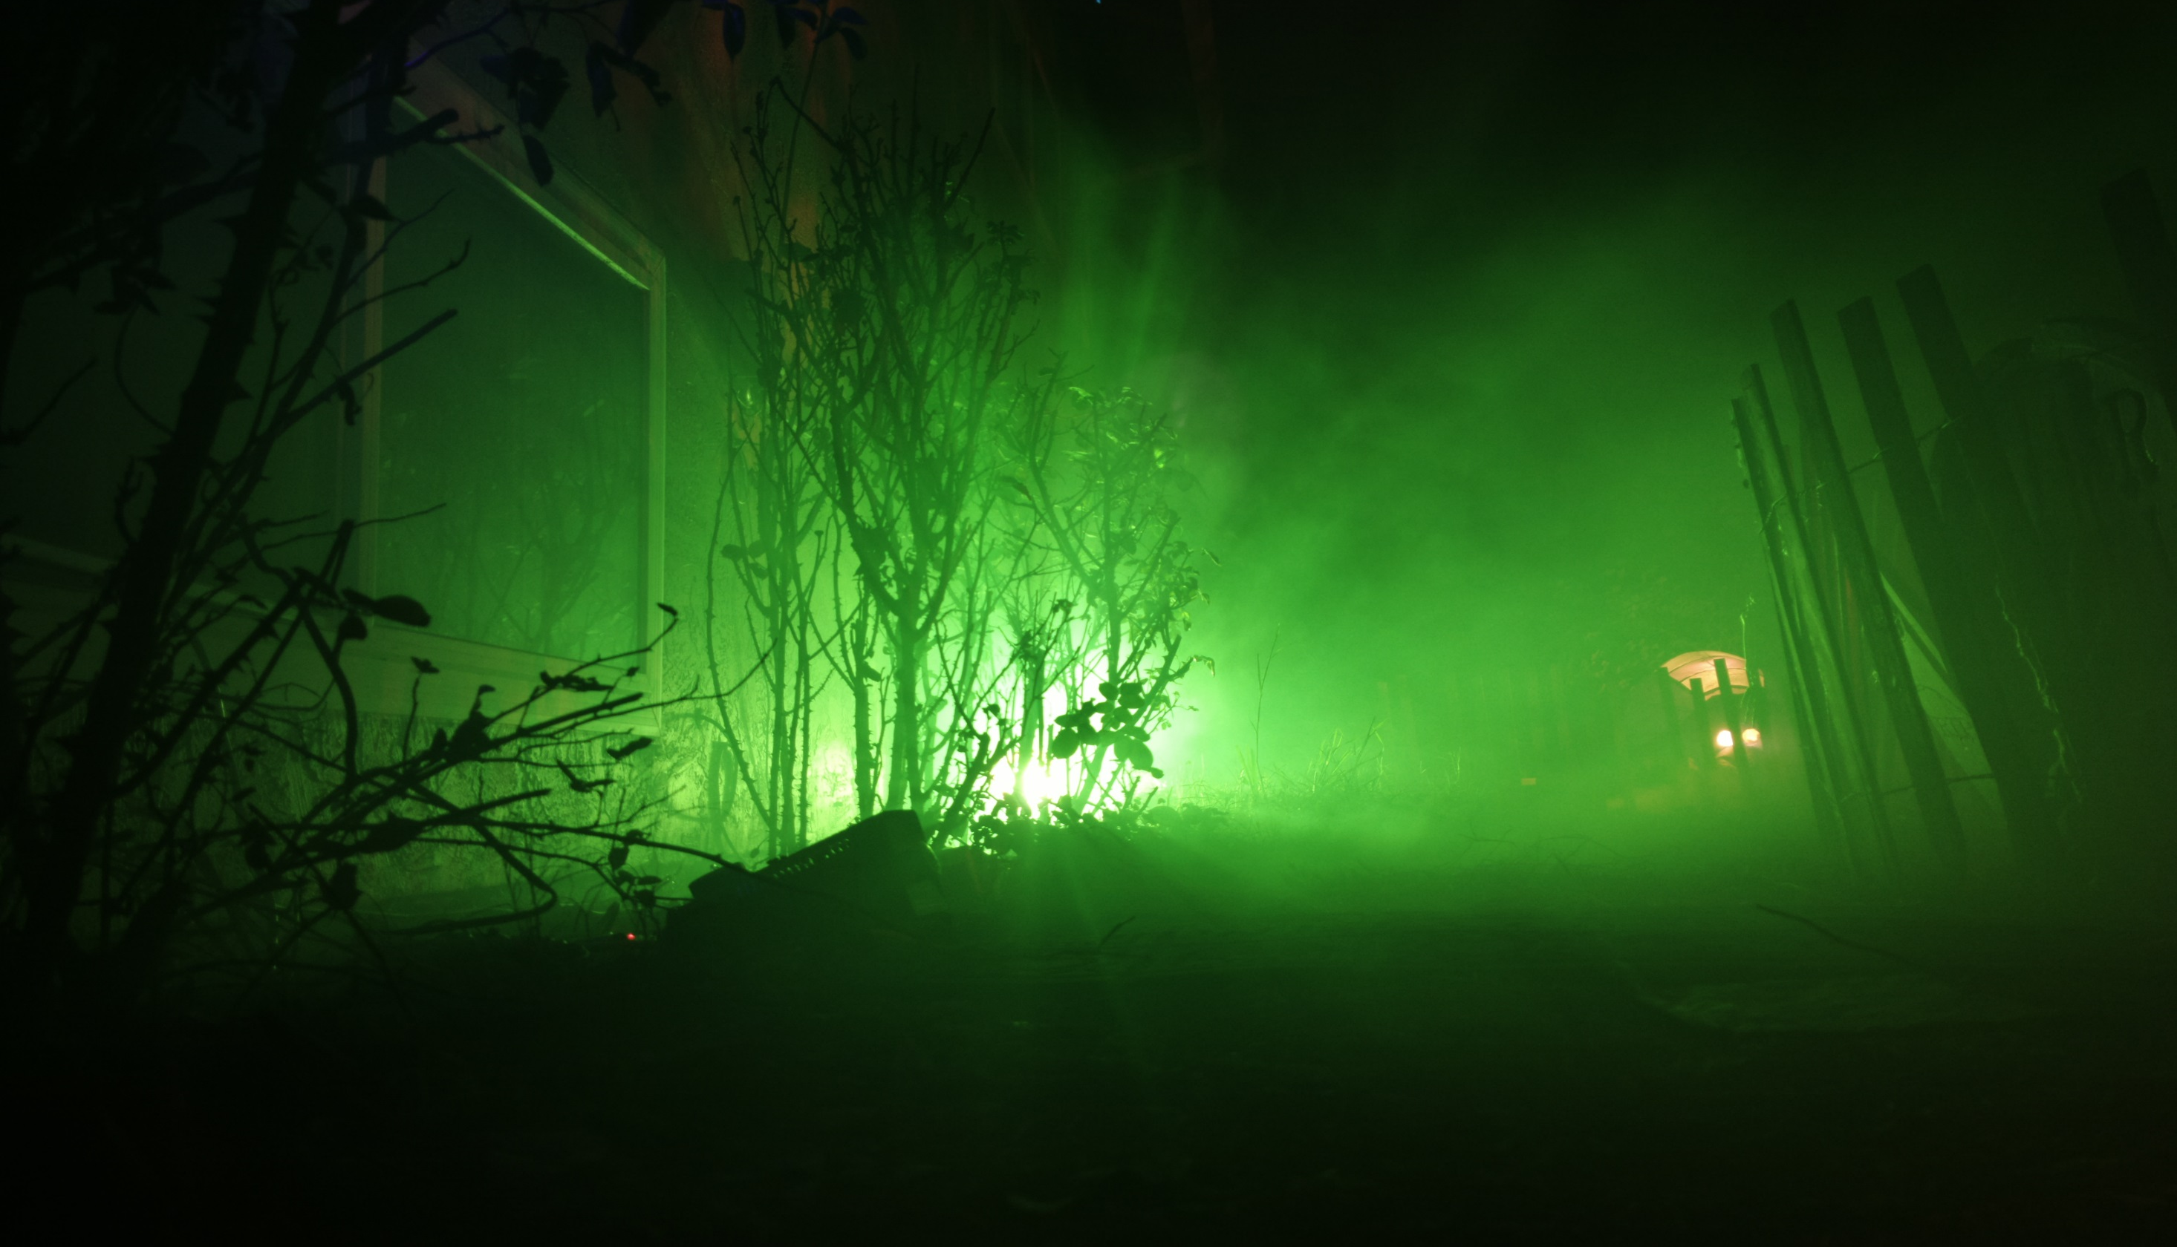
IN THE WRITING JOURNAL TAB IN YOUR BINDER
Write this story.

Slide 10
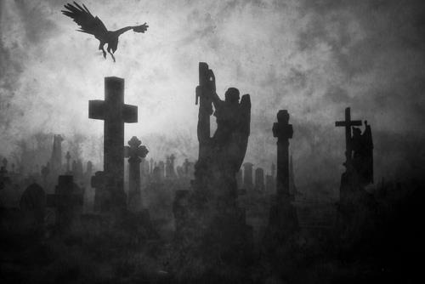
IN THE WRITING JOURNAL TAB IN YOUR BINDER
Write this story.

Slide 11
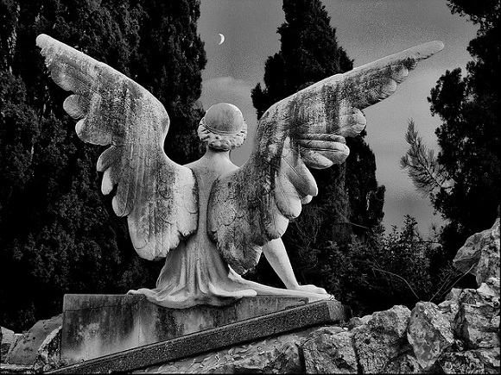
IN THE WRITING JOURNAL TAB IN YOUR BINDER
Write this story.

Slide 12
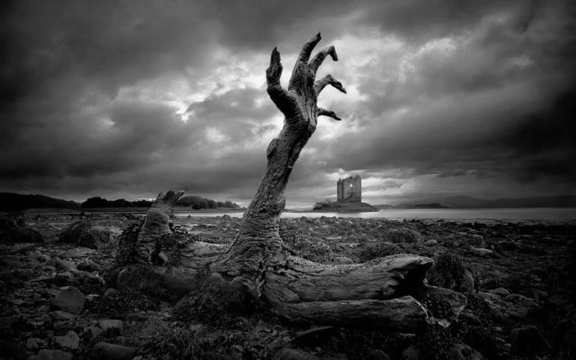
IN THE WRITING JOURNAL TAB IN YOUR BINDER
Write this story.

Slide 13
In the writing journal tab in your binder, copy the sentences and finish this story.
I enter the empty elevator and push the button for my floor. As the doors close I feel a hand cover my mouth.

Slide 14
The phone rang. "Hello," I said, "Hello." No one was there. I hung up. All the lights went out...
In the writing journal tab in your binder, copy the sentences and finish this story.

Slide 15
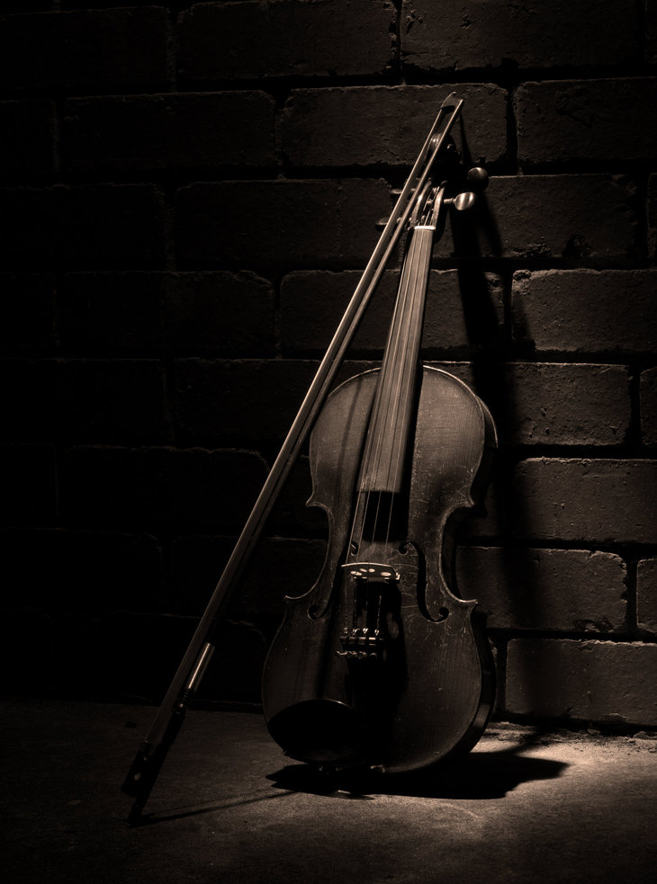
I heard the music as I entered the room, but all that was there was a violin, lay there on it's back on the bare floorboards.
In the writing journal tab in your binder, copy the sentences and finish this story.

Slide 16
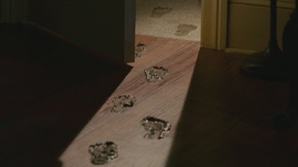
My dog's muddy paws tell me he has been to the cemetery again. The footsteps in the hall tell me he has not returned alone.
In the writing journal tab in your binder, copy the sentences and finish this story.

Slide 17
He floated in the rowboat under the moonlight. "The lake is so peaceful at night," he thought until he dipped his fingers in the water and something pulled him in.
In the writing journal tab in your binder, copy the sentences and finish this story.

Slide 18
Everything stopped, people were stood like statues all around me, people in cars, men on bicycles, babies in prams all lifeless, frozen in time.
I'm not afraid of the cemetery. It's the only place the ghosts don't follow me.
We kept the cellar door locked. No one went down there. We were forbidden to. One day when I went by I smelled an odd, familiar smell, like something I hadn't smelled since I was little. The odor got stronger. Finally I got up the gumption to open the door and go down the rickety steps.
The problem with sneaking out is that your parents have no idea where to look for you. By the time they find this cage you will not be alive.
Tearing down a wall to build an addition to our home, I discovered a small narrow room hidden between the walls. We'd lived there for decades and never knew it was there. And what was in it gave me the shock of my life.
I pressed the button on the remote again and again, but it was no use. The TV just wouldn’t turn off. And there was the face on the screen again, crying out to me. The face of…
The hand burst up out of the soil, fingers twitching as they touched fresh air again for the first time in decades. He was back and, this time, he was determined to…
Finally to his car he drove away from there as fast as he could. When he felt safe enough to breathe a voice from the backseat said, "Leaving so soon?"

